Slide 1
Object Oriented Programming LAB # 03 In-Depth Understanding Of Access Modifiers
ENGR SANIYA SARIM

Slide 2
Access Modifiers
Introduction:
Access modifiers are keywords used to specify the declared accessibility of a member or a type.

Slide 3
Why to Use Access Modifiers?
Access modifiers are an integral part of object-oriented programming. They support the concept of encapsulation, which promotes the idea of hiding functionality. Access modifiers allow you to define who does or doesn't have access to certain features.

Slide 4
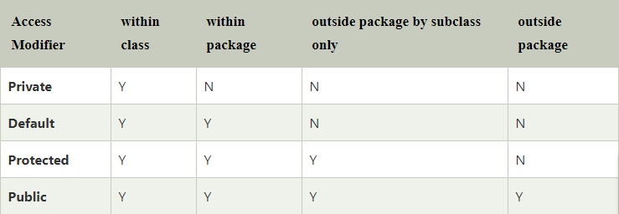
Types Of Access Modifiers
In JAVA there are 4 different types of Access Modifiers.

Slide 5
Public
The public keyword is an access modifier for types and type members. Public access is the most permissive access level.
There are no restrictions on accessing public members.
Accessibility:
Can be accessed by objects of the class
Can be accessed by derived classes

Slide 6
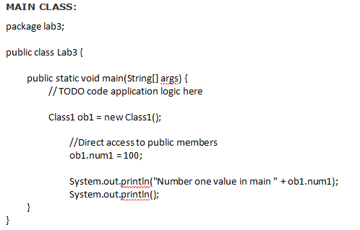
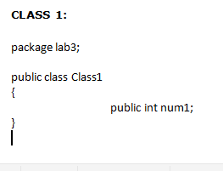
Example(Public)

Slide 7
Private
Private access is the least permissive access level.
Private members are accessible only within the body of the class or the struct in which they are declared.
Accessibility:
Cannot be accessed by object
Cannot be accessed by derived classes
Example:
In the following example num2 is not accessible outside the class.

Slide 8
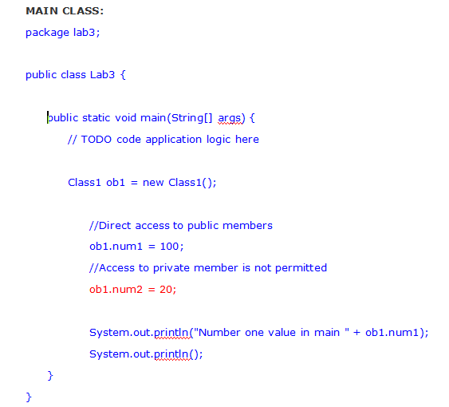
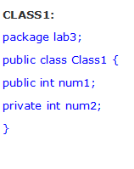
Example(Private)

Slide 9
Protected
A protected member is accessible from within the class in which it is declared, and from within any class derived from the class that declared this member.
A protected member of a base class is accessible in a derived class only if the access takes place through the derived class type.
Accessibility:
Cannot be accessed by object
By derived classes
Classes within same package

Slide 10
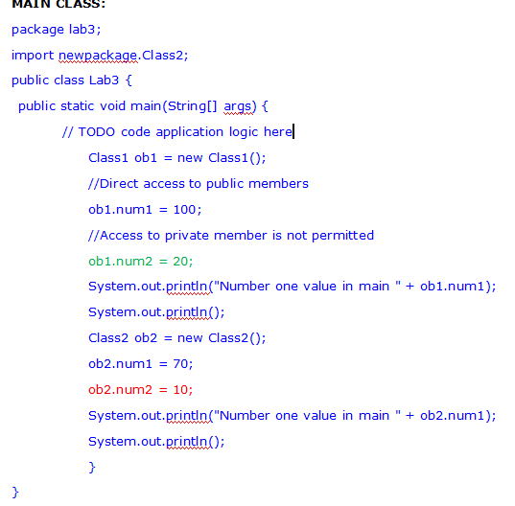
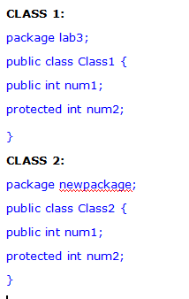
Example(Protected)

Slide 11
Exercise
Create a class Cylinder and use getter and setter methods to set its radius and height.
Also calculate surface area and volume of Cylinder.

Slide 12
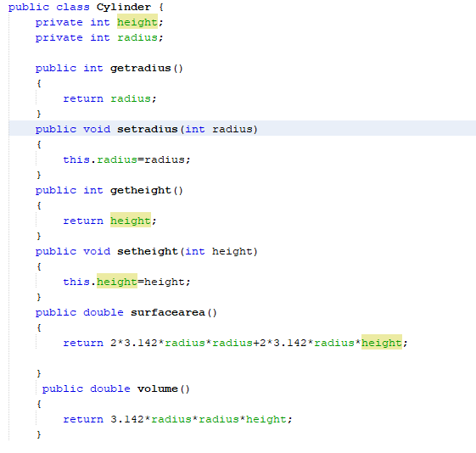
Example( Cylinder Class)

Slide 13
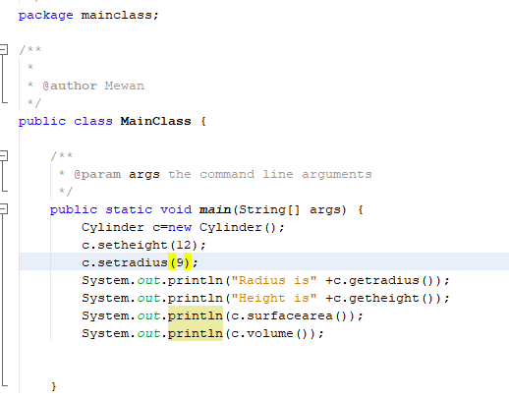
Example (Main Class)

Slide 14
This Keyword
If the attribute in method header has the same name as the class attribute then use this keyword with class attribute.
The various usages of 'THIS' keyword in Java are as follows:
It can be used to refer instance variable of current class
It can be used to invoke or initiate current class constructor
It can be passed as an argument in the method call
It can be passed as argument in the constructor call
It can be used to return the current class instance

Slide 15
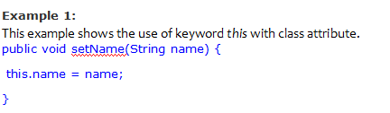
Example(This Keyword)

Slide 16
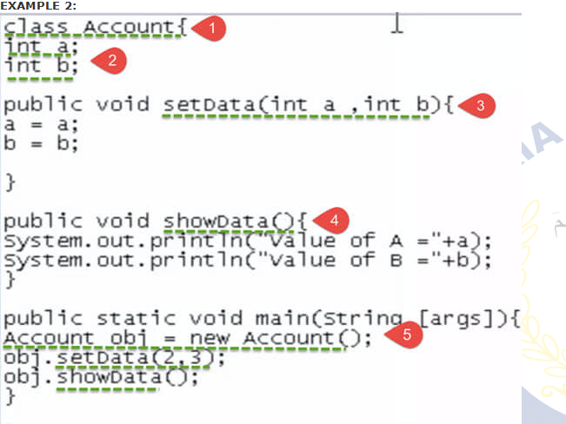
Example 2

